Slide 1
Quarterly HPA Review
Bhavya Puttalingappa

Slide 2

AM PMO Activities
Baseline Reviews (Annually)
Highly Privileged Accounts (HPA) Reviews (Quarterly)
Termination Reviews (Monthly)
IDM Reconciliation (Weekly)
IdM Duplicate Accounts Cleanup (Quarterly)
Database Accounts Password Reset (Quarterly)

Slide 3
Highly Privileged Accounts (HPA) Review
IM team to extract all active accounts in the application/infrastructure.
Review the account list to identify all highly privileged accounts.
Identify the appropriate “Authorized Approver”* for every active highly privileged account.
Send the entire users list to the Access Management PMO team.
Collect Data
1
2
1. PMO to upload all HPA accounts into OIA
2. Initiate entitlement reviews (authorized owner reviews) to review access appropriateness
Initiate Reviews
Defects Rollout
3
1. PMO to download report from OIA
2. Roll out report to IM Owners highlighting defects
4
1. IM Owner removes/alters HP access of any defect / discrepancy identified during review
2. Extract Highly privilege user list and send to Access Management PMO team.
Resolve Defects
Report / Documentation
5
1. Review active user list to ensure all defects are resolved
2. Document test plans and report
IM Owner responsibility
AM PMO team responsibility
*Authorized Approver (AA): Functional Owner, IM Owner, Module Owner, GE Manager/Sponsor, etc
Note: IM Owners are responsible to understand and identify the most appropriate “Authorized Approvers” to validate/approve the HP accounts

Slide 4
Highly Privileged Access (HPA) Definitions -
(applies to non ISS managed assets only (business managed infrastructure)
Applications:
Any account (personal or non-personal) with:
System Administrator privileges, including but not limited to the following:
Ability to create/modify/delete users or set/change passwords
Modify or promote code (production environment)
Override of application controls that the business relies on
Change configurable parameters
the ability to change master data (i.e. customers, vendors, products, prices…) that impact business functions and/or global definitions
Any additional accounts identified by the application owner and/or functional owner that are considered privileged
Databases:
Any account (personal or non-personal) that:
has database administrative functions (ex: role = DBA… may also include management or monitoring accounts)
can alter schemas (ex: schema ancillary accounts)
manages users (ex: can create, modify, delete users; alter privileges or passwords, etc.)
OS / Domains:
Any account (personal or non-personal) that has privileges to do the following:
Create, delete, and/or modify users within the system
Modify permissions for users within the system
Administrative-level access or other unrestricted access to modify system level settings
Example: For *nix, this may include but is not limited to the following:
Root UID
Root GID
PowerBroker group (ex: group 9999)
ldap sudo role which allows user to sudo to root
Legacy systems, suroot permission
Example: For Windows, this may include but is not limited to the following:
Any member, including members of sub-groups, of the Local Administrators group on the windows server
Any member, including members of sub-groups, of the Administrators group in each of the domains. Example: in most of the domains, the Domain Admins group is a sub-group of the Administrators group. In some domains there are other groups (ex: L3 Domain Controller Admins, or Enterprise Admins)

Slide 5
HPA Activities
Scope Finalization:
Based on our previous quarter review we finalize the scope once we receive the scope file from the client
Check for the Asset owner and additional contact details
Check for the activeness of the asset
Check weather the application was marked as out of scope or NO HPA users, if so then we are excluding that application from the review.
Upload Sheet Creation:
Once the scope is finalized we upload the list of application with all other data into the support central to kick off the review.
Requester SSO should be the PMO assigned person to that application
Asset Id to Asset type get the information from the scope file.
Audit year should be Quarter + Year (Ex: Q1 2017)
Access Management Team contacts - SSO separated by comma and space – who ever needs access to the workflow their SSO should be given here
Due Date – Review due date common to all type of reviews.
Baseline Annual(*), HPA(*), IT SOD - Quarterly(*), CBI - Quarterly(*), HPA ERP – which ever review is applicable in that particular column give it as Yes or else No
Applicable Review – need to mention the type of reviews applicable for the Asset (Ex: HPA, CBI)
Attached is the sample upload data
Attached is the document showing how to upload the data sheet to the support central workflow

Slide 6
Collection of Data
Score Card preparation:
Based on the scope file we prepare the score card which includes:
Application Information - Application Name, Asset owner details, category, type etc..,
ACTIVE USER LIST COLLECTION – gives the information about the workflow status and user list and initial documentation.
OIA KICK OFF – for the application for which AUL is complete we create the master sheet and kick off the review through OIA – this gives the infoemtion about the accounts count and the number of applications for which OIA kickoff is complete.
DEFECT REMEDIATION – After the OIA review is complete, based on the BI report we create the review report and for which applications defect is present we send that application for defects removal to the asset owner. – This gives the information about for which application the defects are rolled out , remediated and the final documentation status.
Attached is the sample score card
Collection of Data
User List check list
Once we receive the user list from the application team through workflow we need to review the user list
There should be a user list and screen shot evidence in the required format
User List :
Application or Asset Name
User SSO – valid 9 digit SSO ID
User ID/Account Name – this is optional
HPA Role – The HPA role that particular account owns.
Authorized Owner – 9 digit SSO (manager, IM owner, who can authorize the User) – The User SSO and authorize owner SSO cannot be same.
Screen shot evidence:
Application Name or the production instance from where the list is extracted.

Slide 7
Initialization of the review
Master Sheet preparation
This is one of the most important step in the review. Once the user list collection is complete, we need to consolidate the data for all the application. Master sheet consist of all the information that is provided by the application team and necessary details required to perform the OIA review.
The following are the columns which is required to be present in the master sheet.(Kindly use the same format since we are using an automated tool to generate the csv files, these names should be same as below).
Category: To which category the perticular application belongs.eg.:SoX,FISMA..
AccountType: SSO or Non-SSO
OIAFileName: This is the resource type which we have given while creating the resource in OIA.
OIAReferenceName: This is application name and it should be same as in OIA
SSO: User SSO(9 digit)
User Person Type: This is obtained from bulk.
AccountName: NT id if present or else please user the user SSO
RoleName: HPA Role
HPA: Y
RoleDescription(Optional): Role description if given or else please give the HPA role
AuthorizedOwner: 9 digit SSO
AuthorizedOwner Person Type: took it from Bulk
Account status: Active or Inactive
accountCreateDate: blank.
Check list for Master Sheet:
There should not be any blanks in the above mentioned columns.
User SSO and authorized owner SSO should not be same.
Concatenate user SSO with role there should not be any duplicates.
Concatenate account id with role there should not be any duplicates.
One role should have only one authorized approver, if there are more then concatenate role with user SSO and make the role unique.
Same account id should not be there more different user SSO, please change the account id to user SSO.
If account type is officer please exclude those account from the review.
If authorize owner is officer then need to check that it is all properly delegated.
If authorize owner is inactive then please contact the application team and get the present authorized owner information.
Please refer below is the tool used to review the role based master sheet.
URL:http://libraries.ge.com/download?fileid=866876791101&entity_id=64384259101&sid=101

Slide 8
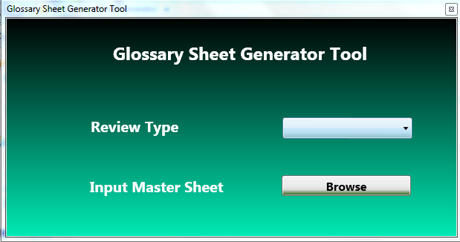
Initialization of the review
CSV file generation 1
Manually:
Accounts File: This file contains the user information. Please copy and paste the below mentioned columns from the master sheet. There is no change in the information.
Glossary File: This file contains the information about the authorize owner. The common value between these two files is HPA role. Based on the roles the mapping is done in OIA.
Copy the role and authorized information for each of the application and remove duplicates. Then fill the remaining information in the file.
Automated Tool:
Glossary file Generation: http://libraries.ge.com/download?fileid=824875843101&entity_id=64384259101&sid=101
The above tool is used to get the accounts and glossary files. Select the review type as GE Aviation-HPA. The Input master file should be saved as “GE Aviation-HPA” and upload the master file. The output file will be saved in the same location.
Category | Accounts Type | ServiceNow CI | OIA reference name | SSO | Account Name | Role Name | HPA | accountType | accountCreateDate
Category | ServiceNow CI | OIA reference name | Role | Role Name | Owner | classification | Role Definition | comments

Slide 9
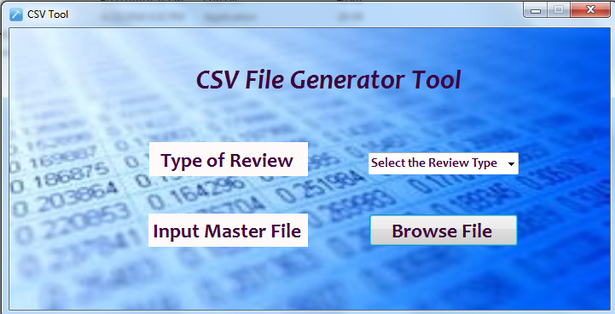
Initialization of the review
CSV file generation 2
Once the account and glossary files are ready. We need to convert it to .csv files with different application names.
Manually:
Download Import Template from ACT tool and save as .csv file and fill all the mandatory fields from the respective accounts and glossary
Automated Tool:
CSV generator Tool: http://libraries.ge.com/download?fileid=824877873101&entity_id=64384259101&sid=101
The above tool is used to get the csv files for each of the applications separately. We can the same out put file which we obtained from Glossary file generator or the files created manually. Select the review type as GE Aviation-HPA. The Input file should be saved as “GE Aviation-HPA” and upload the file. The output excels will be saved in the same location along with the summary sheet.

Slide 10
Initialization of the review
OIA KICK OFF :
Upload the account and glossary files with respect to the application names.
OIA Score card:
Once we upload the files we will receive and automated email to the custom DL which we have given while creating the resource.
Please take the success and terminated count.
Take the OIA count from the tool.
The OIA count and success count should be same then only we can proceed with the review.
Once we kick off the data owner review through OIA, please download the Workflow History Report and match the subtract(OIA accounts CSV file # - Term#) with WF count. If there is any mismatch then please find out for which accounts the review is not initiated, raise RITM ticket and recreate the cert6ification for the missed accounts.
Please refer to the below document to upload the csv files and to create the certification:
Resource Creation in OIA:
Creating Certification:
Download BI Report:

Slide 11
Defects roll out and resolve defects
Defects Roll Out:
Once the OIA review is complete and all the certifications are expired we need to roll out the defects to the application owner and get them remediated.
Review Report:
This report contains all information about the accounts similar to the master sheet along with the reviewer response.
Download the BI report.
Concatenate OIA Reference name(application name)+User SSO+HPA Role in the review report and in BI report.
Apply “Vlook up” for this column and get the reviewer response.
Get the account status from the idm Bulk data.
If any certified accounts are inactive please change it to the INACTIVE and ask the application owner to remove those accounts.
Please find attached below is the sample Defects Report(Review report):
Resolve Defects:
Roll out the defects report along with the counts to the application owner using the workflow and get the updated user list along with the screen shot evidence.
Review the list and check that all the defects are removed and save the document as final user list.
OIA KICK OFF :
Defects Roll Out:
Test Plan Creation:

Slide 12
Report / Documentation
Test Plan:
This document contains all the information on the review.
List of scoped applications
Summary on the accounts count
Summary on the certified and defects counts
Initial and final user list documents
Review Report and Defects report
Email approvals(Any)
Find attached is the sample test plan:
OIA KICK OFF :
Defects Roll Out:
Test Plan Creation:

Slide 13
2014 – Access Reviews Execution Method
Activities
Collect Data
Initiate Reviews
Access Appropriateness Reviews
Defects Rollout
Defect Remediation
Report & Document
Termination Accounts Reviews (Monthly) Non-IDM assets
Complete AUL (SSO Accounts only)
Upload user list in OIA to identify term defects
N/A
Download Termination defects from OIA & roll out
Remove access for defects identified
Document Test results
Highly Privileged Accounts (HPA) Reviews(Quarterly)
ALL active HPA with authorized owner info
Upload HPA in OIA & trigger Certifications
Authorized Owners to review HPA & Certify thru OIA
Download Certification report from OIA & roll out
Remove appropriate access for defects identified
Document Test results
Baseline Reviews IdM Assets: Annual non-IdM: Semi-annual
Complete AUL
Upload user list in OIA & trigger Certifications
User/Manager review access app & Certify thru OIA
Download Certification report from OIA & roll out
Remove access for defects identified
Document Test results
IM Owner Responsibility
PMO Team

Slide 14
Thank You

